Slide 1
Cloud Computing for Managers

Slide 2
Pop Quiz

Slide 3
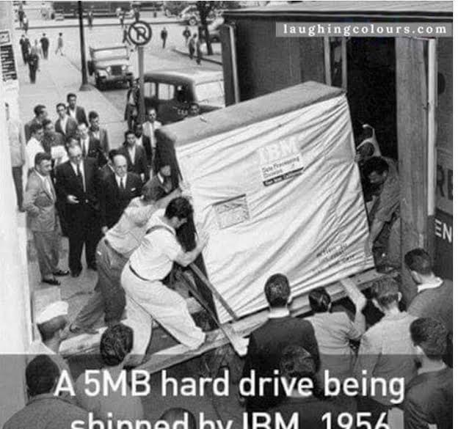
What is this?

Slide 4
What is Cloud Computing?

Slide 5
Cloud Computing
IT resources provided as a service
Compute, storage, databases, queues

Slide 6
Cloud Computing
Clouds leverage economies of scale of commodity hardware
Cheap storage, high bandwidth networks & multi-core processors
Geographically distributed data centers

Slide 7
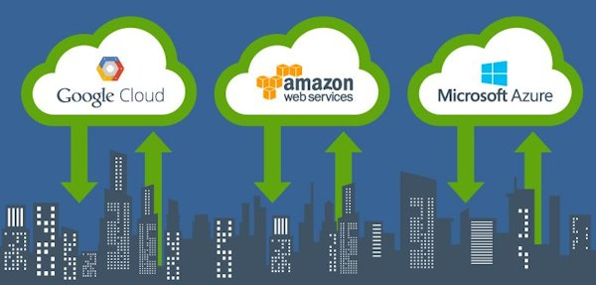
Cloud Providers
Can you name the biggest three?

Slide 8
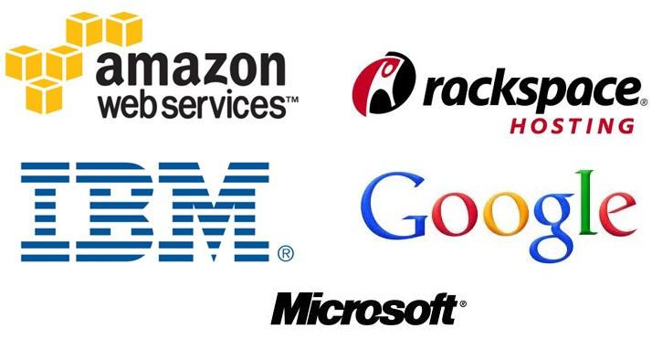
Major Cloud Providers

Slide 9
Do I really need this “cloud” business? Why can’t I simply buy 500 servers (servers are cheap) and run them from my basement?

Slide 10
Let’s List the Benefits

Slide 11
wikipedia:Cloud Computing

Slide 12
Benefits
Cost & management
Economies of scale, “out-sourced” resource management
Reduced Time to deployment
Ease of assembly, works “out of the box”
Scaling
On demand provisioning, co-locate data and compute
Reliability
Massive, redundant, shared resources
Sustainability
Hardware not owned

Slide 13
The Economics of Cloud

Slide 14
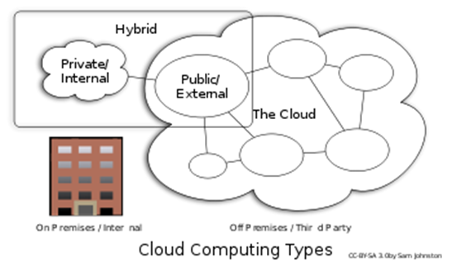
Types of Cloud Computing
Public Cloud: Computing infrastructure is hosted at the vendor’s premises.
Private Cloud: Computing architecture is dedicated to the customer and is not shared with other organizations.
Hybrid Cloud: Organizations host some critical, secure applications in private clouds. The not so critical applications are hosted in the public cloud

